Slide 1
The Srub Lords.
Done by: G8T4

Slide 2
Today’s Agenda
Content Changed
Functionalities
Schedule
Evaluation Metrics
Roles & Responsibilities
Programming Pairs

Slide 3
Content Changed
1
WHAT CONTENT HAS CHANGED FROM THE PM REVIEW?
Critical Path for Iteration 2 and Iteration 3
Updated Bug Metrics

Slide 4
Functionalities
2
DO YOU PLAN TO DROP/ADD ANY FUNCTIONALITIES?
No. We do not plan to drop/add any functionalities.

Slide 5
Functionalities
2
DO YOU PLAN TO USE ANY PHP FRAMEWORKS?
No. We did not use any PHP Frameworks.

Slide 6
Iteration 2 - Functionalities
2
WHAT DID WE FINISH?
Student | Admin
1. Bid for a Section | 1. Round 1 Clearing Logic
2. Drop a Bid | 2. Dump Table (JSON)
3. Drop a Section | 3. Start Round (JSON)
4. View Bidding Results | 4. Stop Round (JSON)
 | 5. Update Bid (JSON)
 | 6. Delete Bid (JSON)
 | 7. Drop Section (JSON)
 | 8. Dump User (JSON)
 | 9. Dump Bid (JSON)
 | 10. Dump Section (JSON)

Slide 7
Functionalities
2
WHAT IS THE IP ADDRESS AND ADMIN PASSWORD FOR YOUR CLOUD DEPLOYMENT?
IP Address: 18.219.90.60
Password: XmP1z!MPr[

Slide 8
Schedule
3
OVERVIEW SCHEDULE SUMMARY
Iteration 1 (Week 5 to 6): 17 Sept — 30 Oct
Iteration 2 (Week 7 to 8): 1 Oct — 14 Oct
Iteration 3 (Week 9 to 10): 15 Oct — 28 Oct
Iteration 4 (Week 11 to 12): 29 Oct to 11 Nov
Iteration 5 (Week 13 ): 12 Nov — 19 Nov
Front-End development for login and homepage
Implement Bootstrap feature
Create test cases and test login page
Update bug metrics
Creation of JSON, JSON Checker
Implement JSON Functionalities and validations
Implement of bidding features
Implement admin functionality
Run test cases and update bug metrics
Preparation for application demo and progress update
Implement clearing logic (Round 2) feature
Implement live bidding (Round 2) feature
Design Front-End for admin page
Create test cases for clearing logic & live bidding
Preparation for UAT
Refining existing website after UAT’s feedback
Implementation of additional requirements
Prepare for final presentation
Prepare for final presentation
Runthrough final presentation
Present on Final Presentation

Slide 9
Milestones
3
OUR MILESTONES SUMMARY
Milestone description | Dates | Venue
Project Management Review | Week 7 | in-Class
Application Demo and Progress Update | Week 9 | Online
User Acceptance Test (UAT) | Week 11 | in-Class
Post Review on UAT | Week 12 | in-Class
Final Presentation | Week 13 | in-Class

Slide 10
Buffer Time
3
BUFFER TIME FOR EACH ITERATION
2 days for iteration 2 and 3.

Slide 11
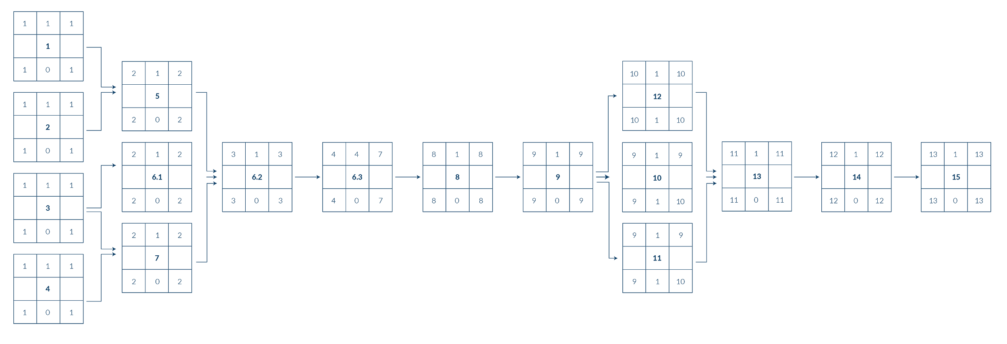
Critical Path: Iteration 1
3
SCHEDULE SUMMARY

Slide 12
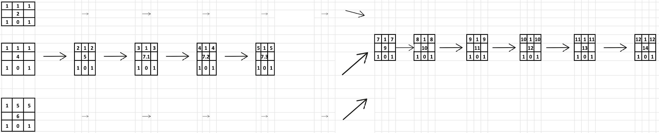
Critical Path: Iteration 2
3
SCHEDULE SUMMARY

Slide 13
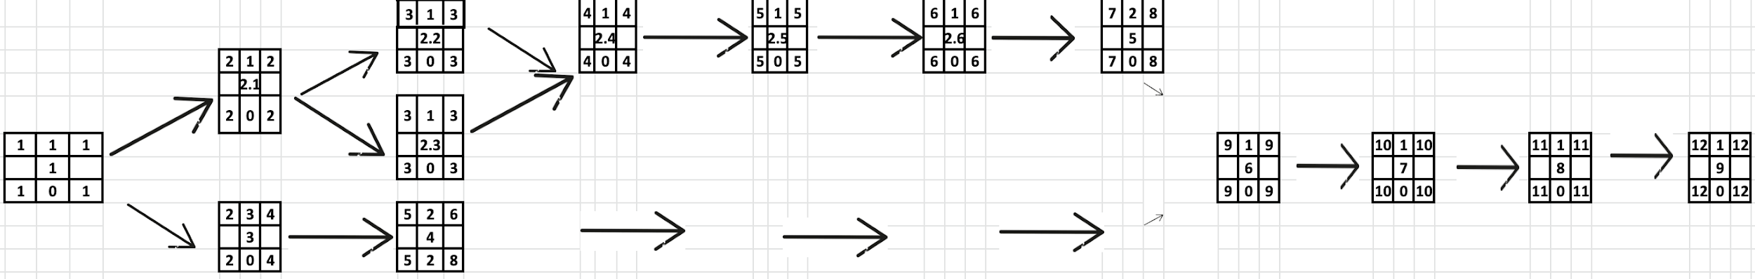
Critical Path: Iteration 3
3
SCHEDULE SUMMARY

Slide 14
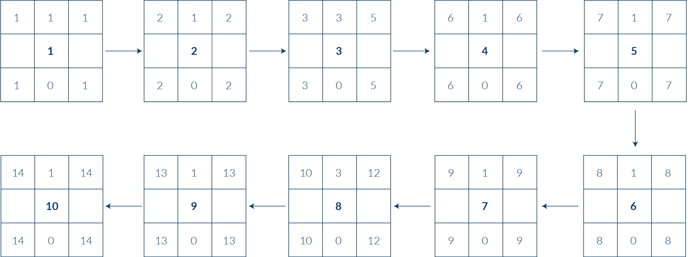
Critical Path: Iteration 4
3
SCHEDULE SUMMARY

Slide 15
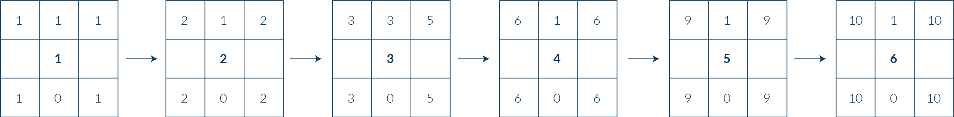
Critical Path: Iteration 5
3
SCHEDULE SUMMARY

Slide 16
Bug Metrics
4
CALCULATION OF IMPACT SCORE & MITIGATION PLAN
Calculation of Impact Score
Severity |  |  | Description
Low Impact (Score = 1) |  |  | Inconsequential. Simple typo error or minor user interface misalignment
High Impact (Score = 5) |  |  | Non-critical functionalities are not working, but the system still runs
Critical Impact (Score = 10) |  |  | The system or core functionality is down. Immediate attention is required
Mitigation Plan
Points in Iteration |  |  | Action
Points < 10 |  |  | Use the planned debugging time in the iteration.
Points ≥ 10 |  |  | Stop current development and resolve the bug immediately. Project Manager reschedules the project.

Slide 17
Iteration 2 - Bug Metrics
4
WHAT IS THE CURRENT VALUE OF METRICS & ANY MITIGATION PLAN?
Iteration 2
S/N | Function | Description | Severity | Points | Final Bug Metric | Mitigation
1 | Protect | The page returns an infinite loop when studentIndex.php, Placebid.php & bidProcess.php is accessed without logging in | Low | 1 | 9 | Use the planned debugging time in the iteration.
2 | Bidding | Displays an error "You have bidded for another section of this course" when updating the bid with an amount higher than the amount of e$ the student has | Low | 1
3 |  | Updating a bid with a lower amount leads to the student losing more e$ | Low | 1
4 |  | Updating a bid with the same name but different case leads to the student losing e$ | Low | 1
5 | Drop Section | User cannot drop a section when round 2 starts | High | 5

Slide 18
Roles & Responsibilities
5
ROLES FOR EACH MEMBER PER ITERATION
Iteration 1 (Project Management Review) [DONE]
Roles | Member
Project Manager | Glen
Pair 1 | Glen & Mary
Pair 2 | Agnes & Kwan Yang
Iteration 2 (Application Demo and Progress Update)
Roles | Member
Project Manager | Mary
Pair 1 | Glen & Agnes
Pair 2 | Kwan Yang & Shourya

Slide 19
Roles & Responsibilities
5
ROLES FOR EACH MEMBER PER ITERATION
Iteration 3 (User Acceptance Test (UAT))
Roles | Member
Project Manager | Agnes
Pair 1 | Glen & Shourya
Pair 2 | Mary & Kwan Yang
Iteration 4 (Post Review on UAT)
Roles | Member
Project Manager | Shourya
Pair 1 | Glen & Kwan Yang
Pair 2 | Agnes & Mary

Slide 20
Roles & Responsibilities
5
ROLES FOR EACH MEMBER PER ITERATION
Iteration 5 (Final Presentation)
Roles | Member
Project Manager | Kwan Yang
Pair 1 | Glen & Mary
Pair 2 | Agnes & Shourya

Slide 21
Thank you.
Done by: G8T4

